Slide 1
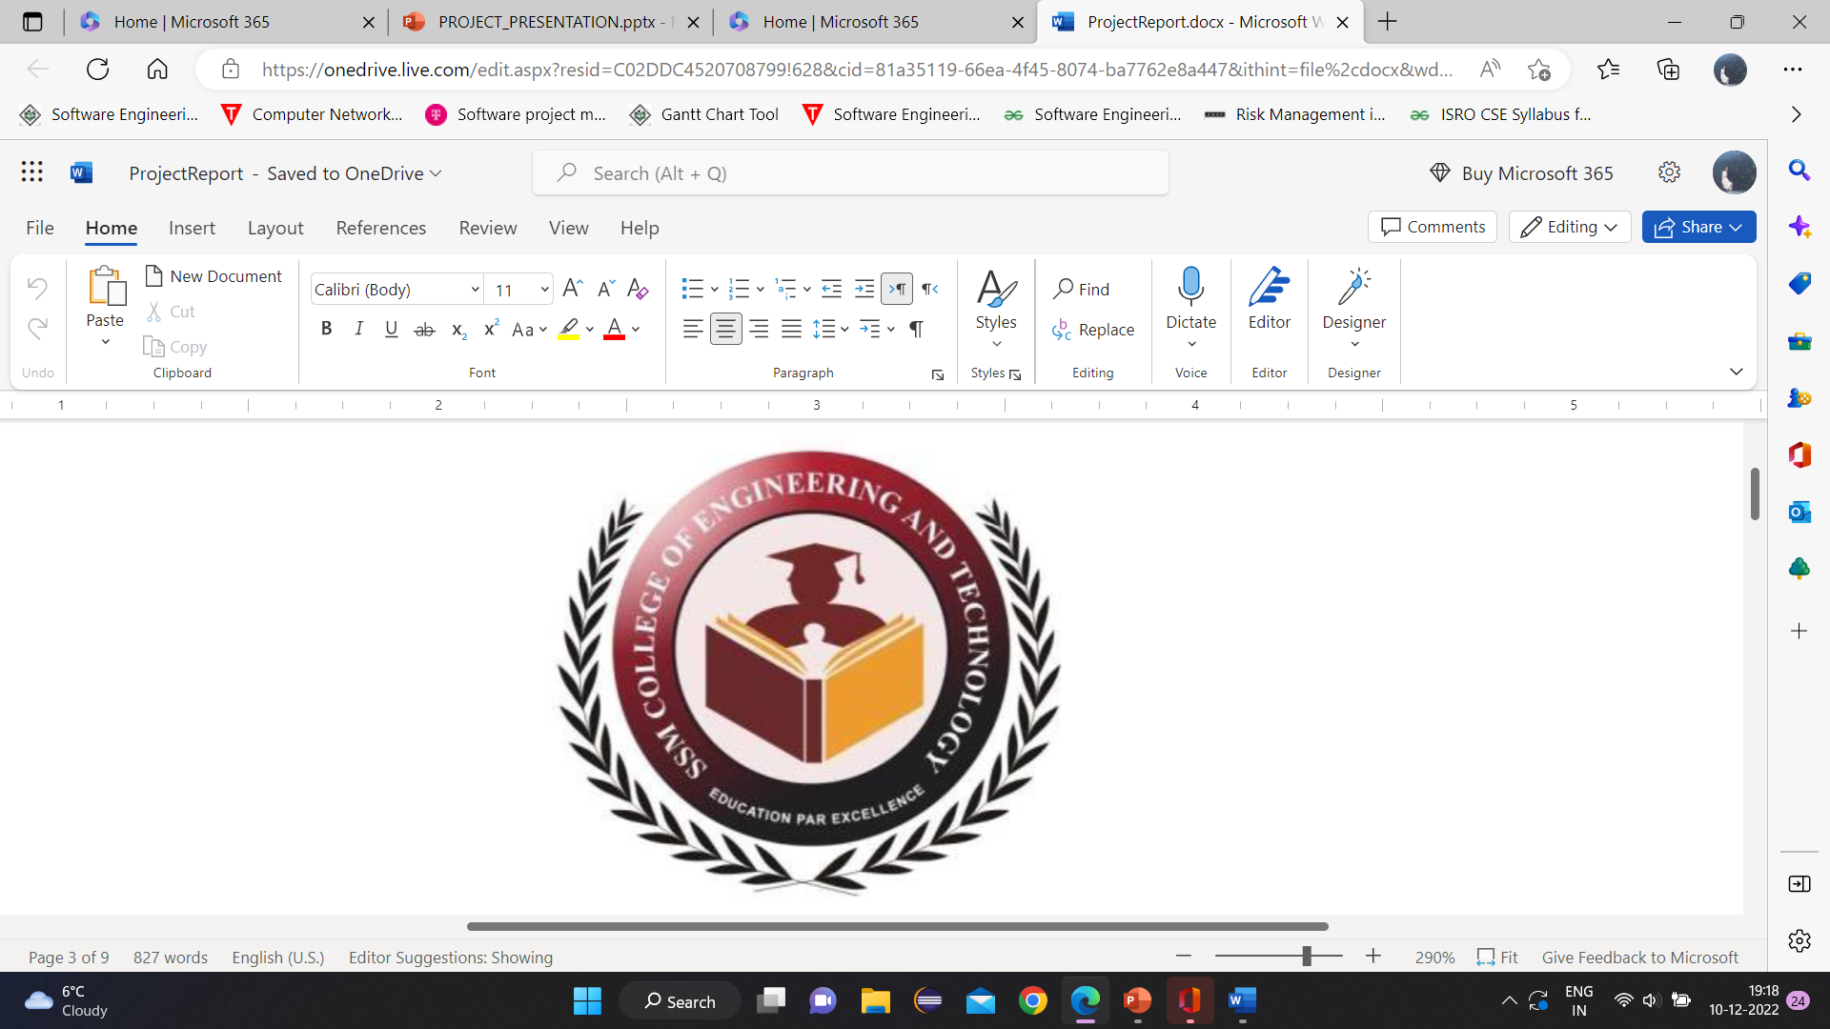

PERFORMANCE Monitoring SYSTEM
SSM COLLEGE OF ENGINEERING
DEPARTMENT OF COMPUTER SCIENCE ENGINEERNG
PRESENTED BY :
ADNAN ASHRAF 18205135050
FARIA FARHEEN 18205135086
SYED DAWAR 18205135094
PROJECT GUIDE :
MRS. Yasmeen viqar HOD CSE

Slide 2
CONTENTS:
Abstract
Algorithm
Modules and Features
Technology and SDLC model used
DFD, Flowchart, ERD and Architecture
Advantages
Working
Future Scope
Conclusion
Introduction

Slide 3
INTRODUCTION:
ASSESS
CATEGORIZE
ENHANCE
The Performance Monitoring System is a web application created in java using the spring framework, that provides an effective methodology to:
Assess the student's performance based on specific criteria.
Categorize the students based on their learning capabilities.
Take measures to enhance student's capacity to achieve higher levels.

Slide 4
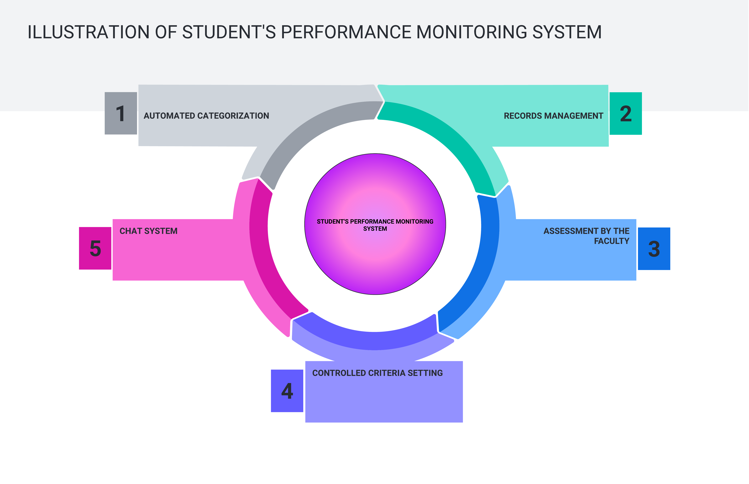

Slide 5
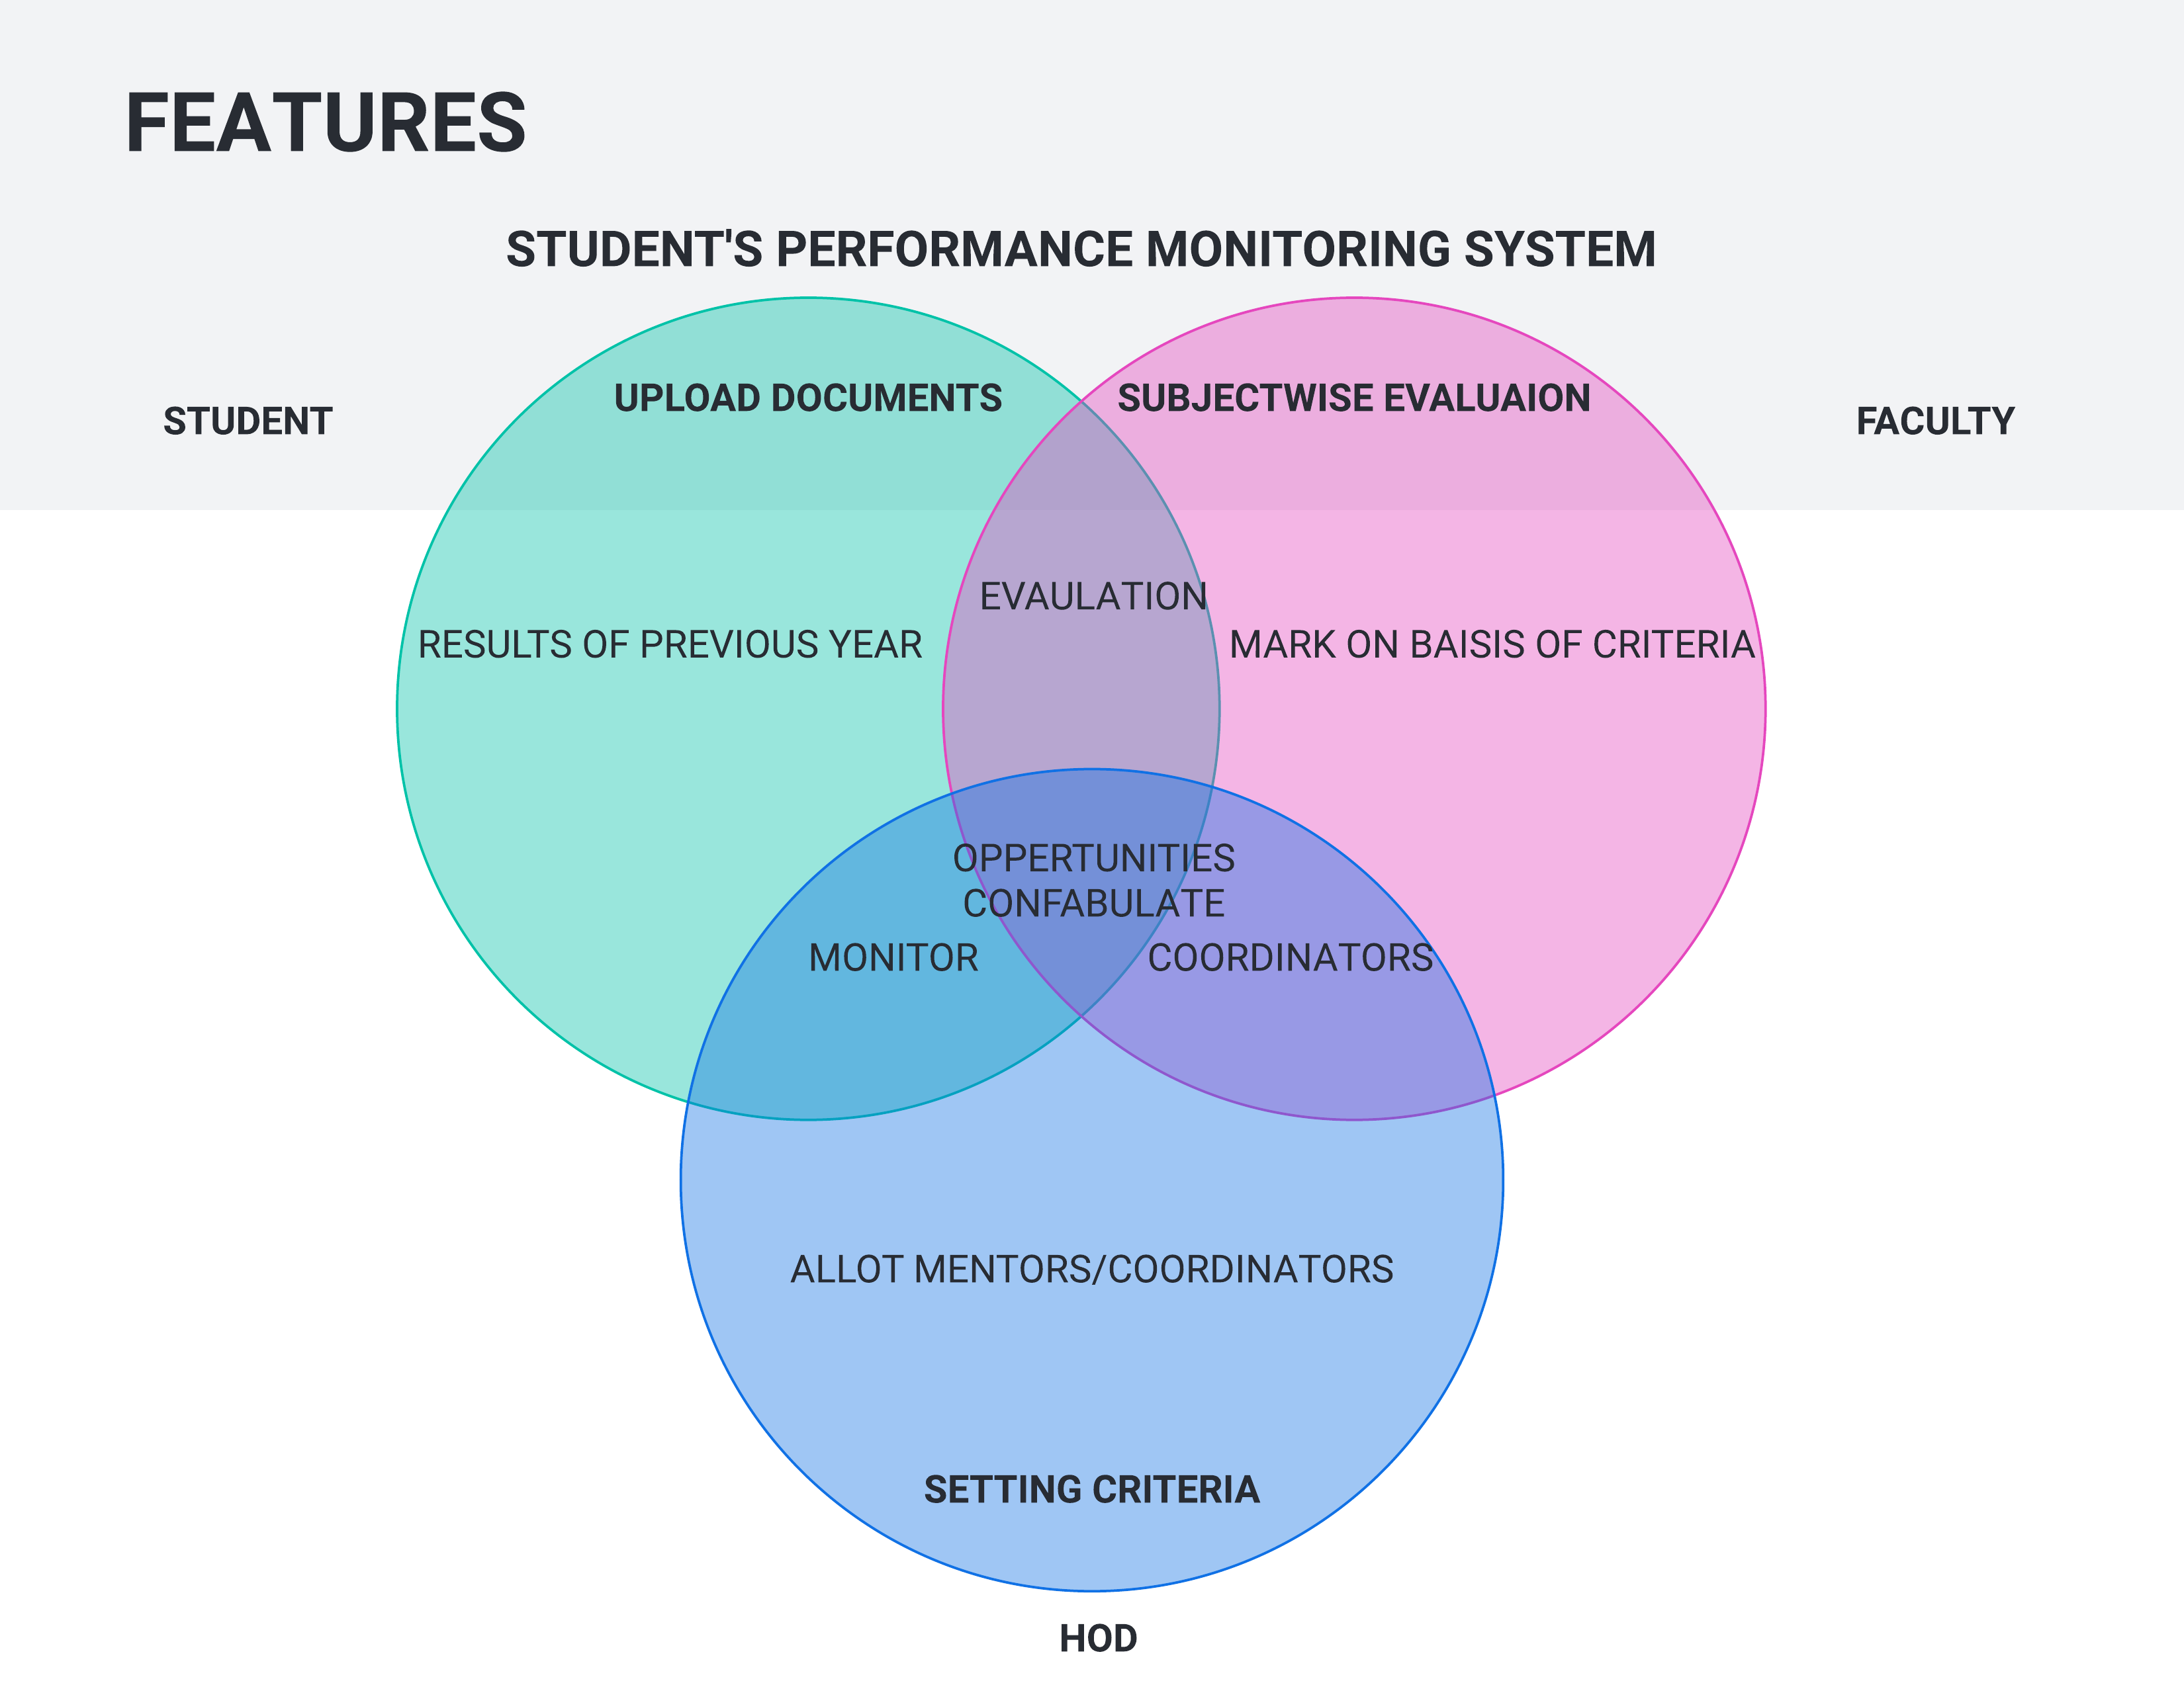

Slide 6
ABSTRACT: 1.CRITERIA FOR Assessment SUB-WISE
Behavior
Attendance
Focus
Subject-wise assessement

Slide 7

ABSTRACT:2.CATEGORIZE STUDENTS
calculate
ASSESSMENT %
PREVIOUS RESULTS %
INTERNAL RESULTS %
FAST LEARNERS
AGGREGATED
PERCENTAGE %
(CRITERIA)
SLOW LEARNERS

Slide 8
ABSTRACT:3.MEASURES TO ENHANCE CAPACITY OF STUDENTS
SLOW LEARNERS:
FAST LEARNERS:
COUNSELLING
PTM
ALLOT REMEDIAL CLASSES
ALLOT MENTORS
ANALYZING THE PROBLEM
ALLOT TASKS
ALLOT ACTIVITIES
ALLOT SEMINARS
PROVIDE INFO OF INDUSTRY TRAININGS
PROVIDE INFO OF PLACEMENTS/EXAMS

Slide 9


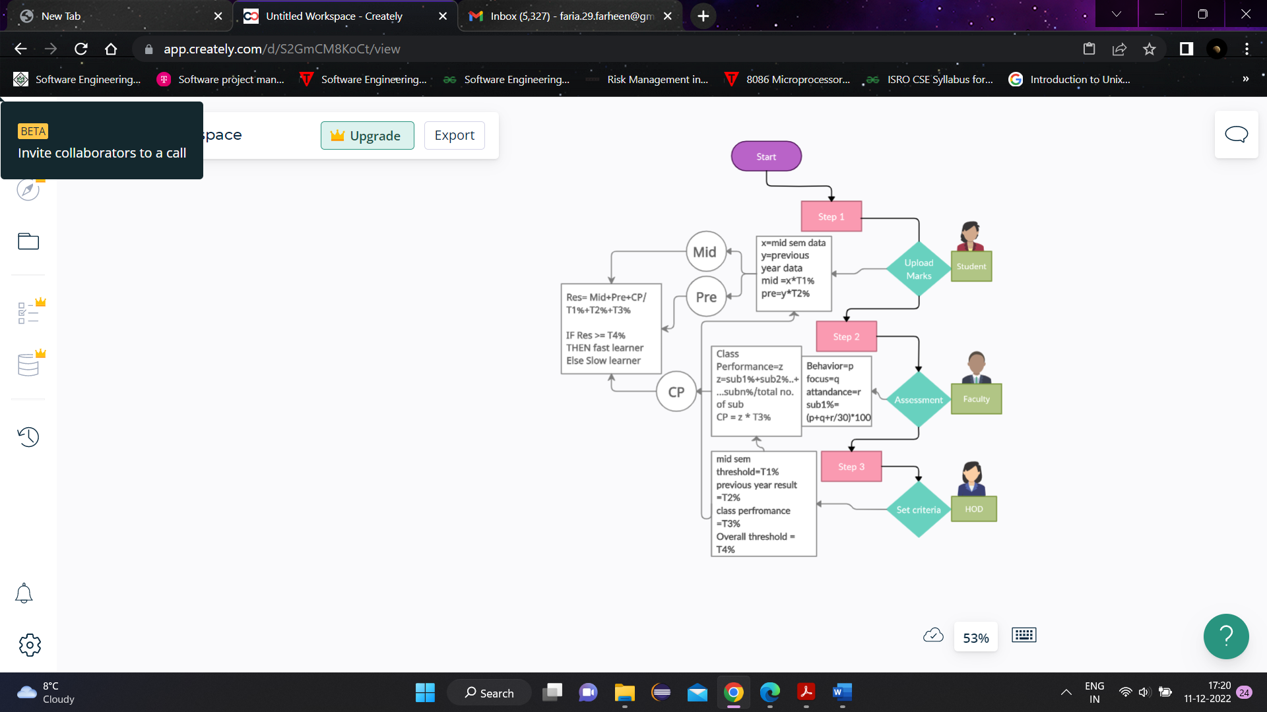
ALGORITHM USED

Slide 10





MODULES:
H
F
C
M
S
HOD
FACULTY
COORDINATOR
MENTOR
STUDENT
1
2
3
4
5

Slide 11
FEATURES:
HOD
ALLOT MENTORS
KEEP AN OVERVIEW OF SLOW AND FAST LEARNERS
FACULTY
SUBJECT WISE ASSESSMENT
VIEW ASSESSMENT
MENTOR
COUNSELLING
STUDENT
ADD PERFORMANCE
VIEW NOTIFICATIONS
KEEP RECORD OF SLOW LEARNERS
DEPT. AND SEM SEARCH
ALLOT COORDINATORS
CHAT SYSTEM
SET CRITERIA
CHAT SYSTEM

Slide 12
FEATURES: FEATURES OF COORDINATOR:
BROADCAST
NOTIFICATIONS
VIEW MENTOR LIST
ADD SUBJECTS OF SEMESTERS
VIEW LIST OF SLOW LEARNERS
PTM
ALLOT COUNSELLING/CLASSES
VIEW LIST OF FAST LEARNERS
ALLOT SEMINARS/ACTIVITIES
INFORM ABOUT PLACEMENTS/EXAMS(career counselling)

Slide 13
TECHNOLOGY USED:
BACKEND
JAVA
DATABASE
MYSQL
FRONTEND
Enterprise edition
BOOTSTRAP
TEMPLATES

Slide 14
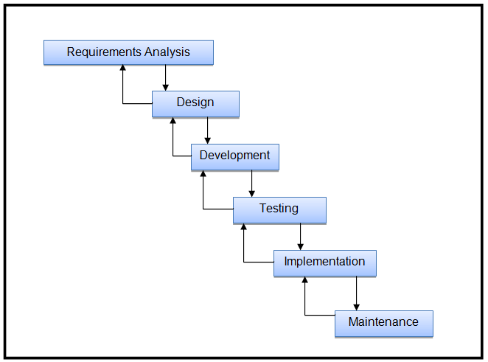
MODEL: ITERATIVE WATERFALL

Slide 15
ADVANTAGES:
1.
AUTOMATION ENHANCES THE EFFECTIVENESS
2.
FASTER AS COMPARED TO MANUAL METHOD
3.
INDIVIDUAL RECOGNITION AND ENCOURAGEMENT
4.
IMPROVEMENT IN RESULTS
5.
INTERACTIVE

Slide 16


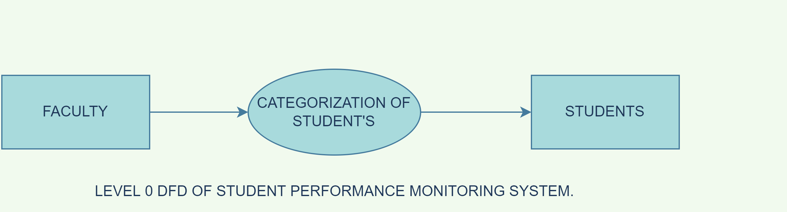
DATA FLOW DIAGRAM CONTEXT LEVEL

Slide 17


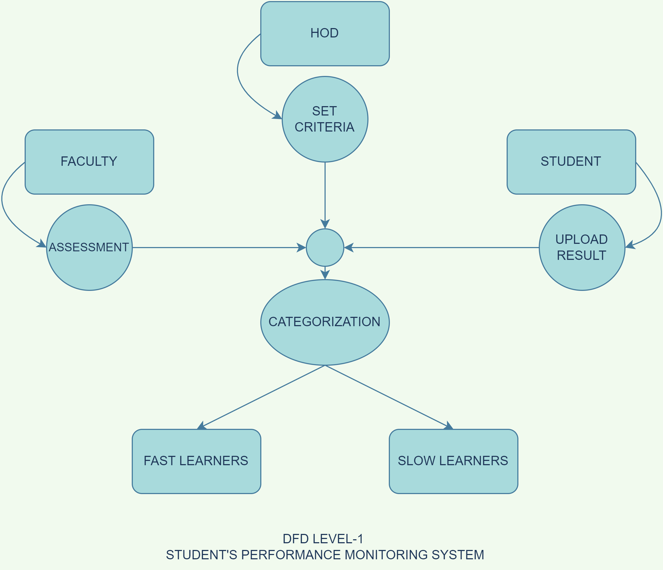
DATA FLOW DIAGRAM

Slide 18
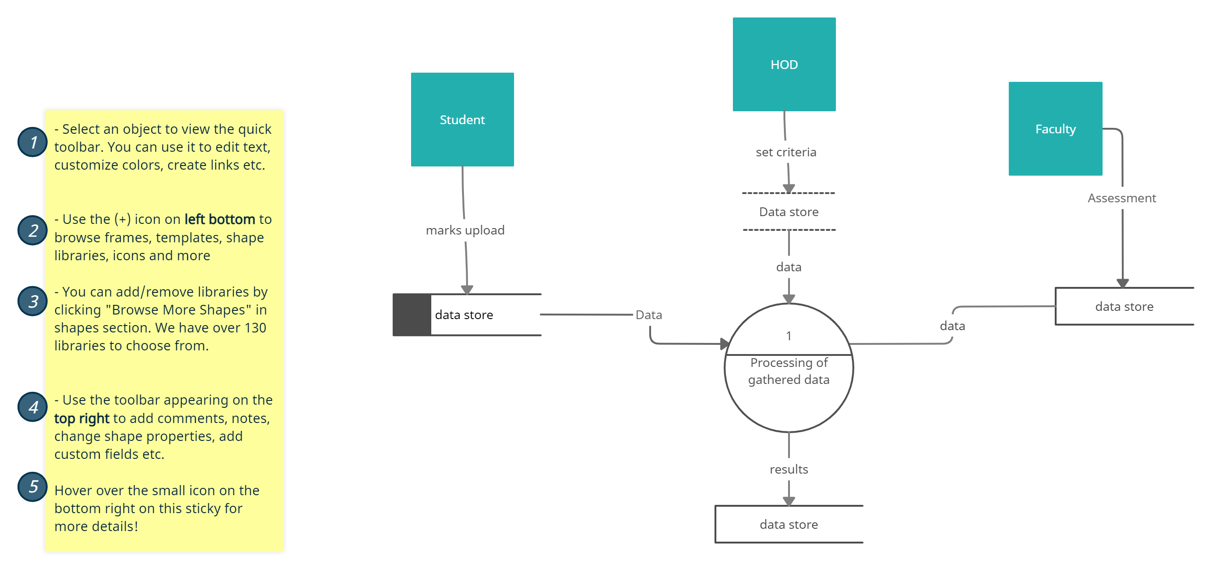
LEVEL2-DATA FLOW DIAGRAM

Slide 19

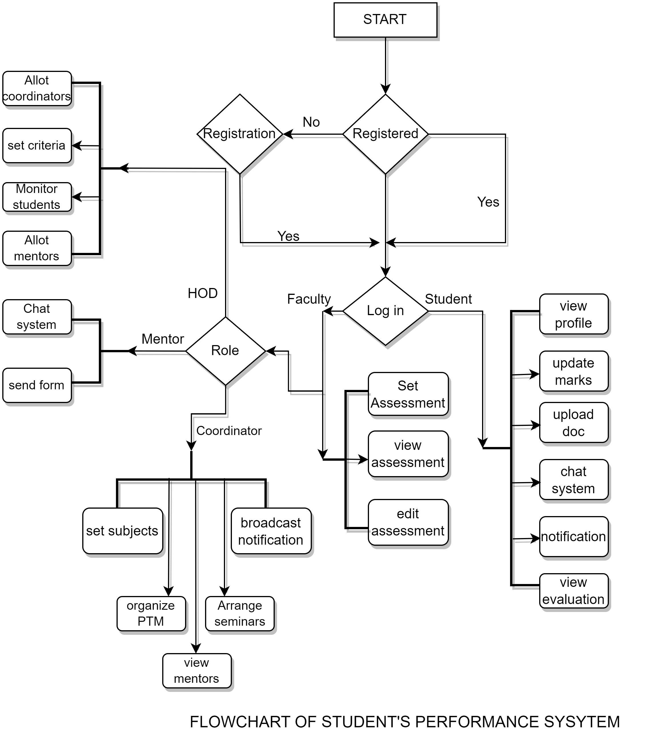
FLOWCHART OF THE SYSTEM

Slide 20

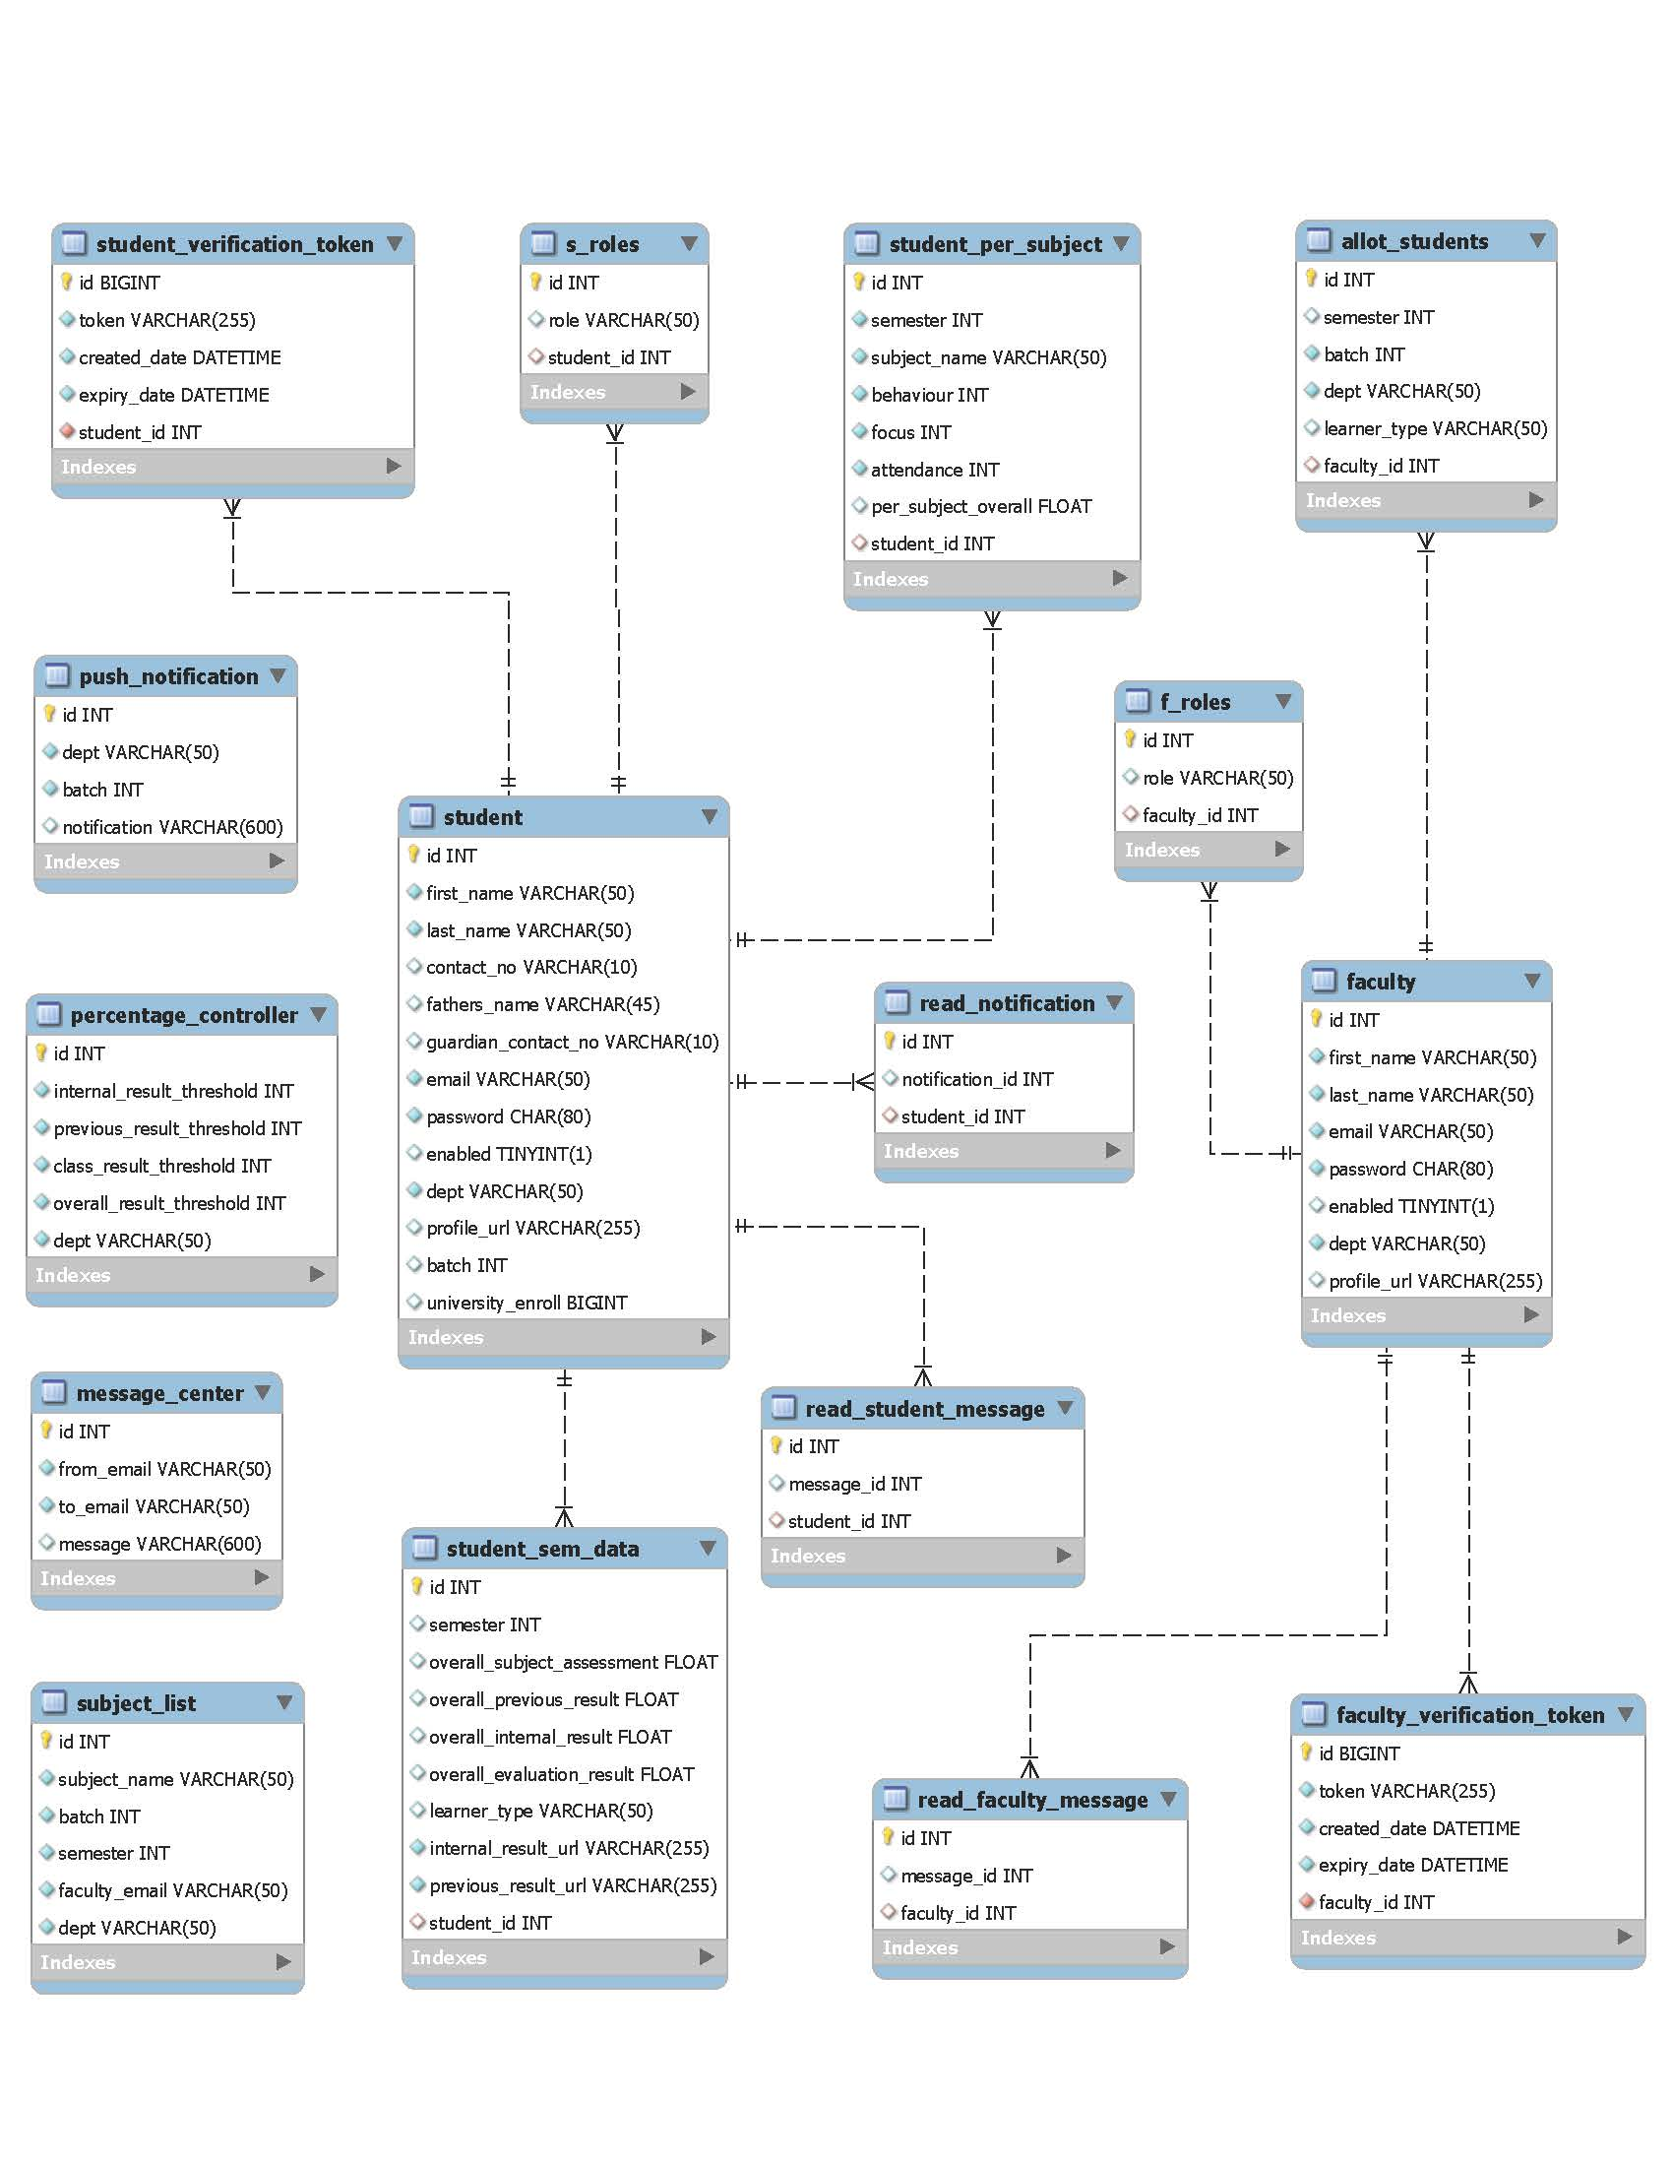
ENTITY-RELATIONSHIP DIAGRAM

Slide 21

SYSTEM ARCHITECTURE

Slide 22
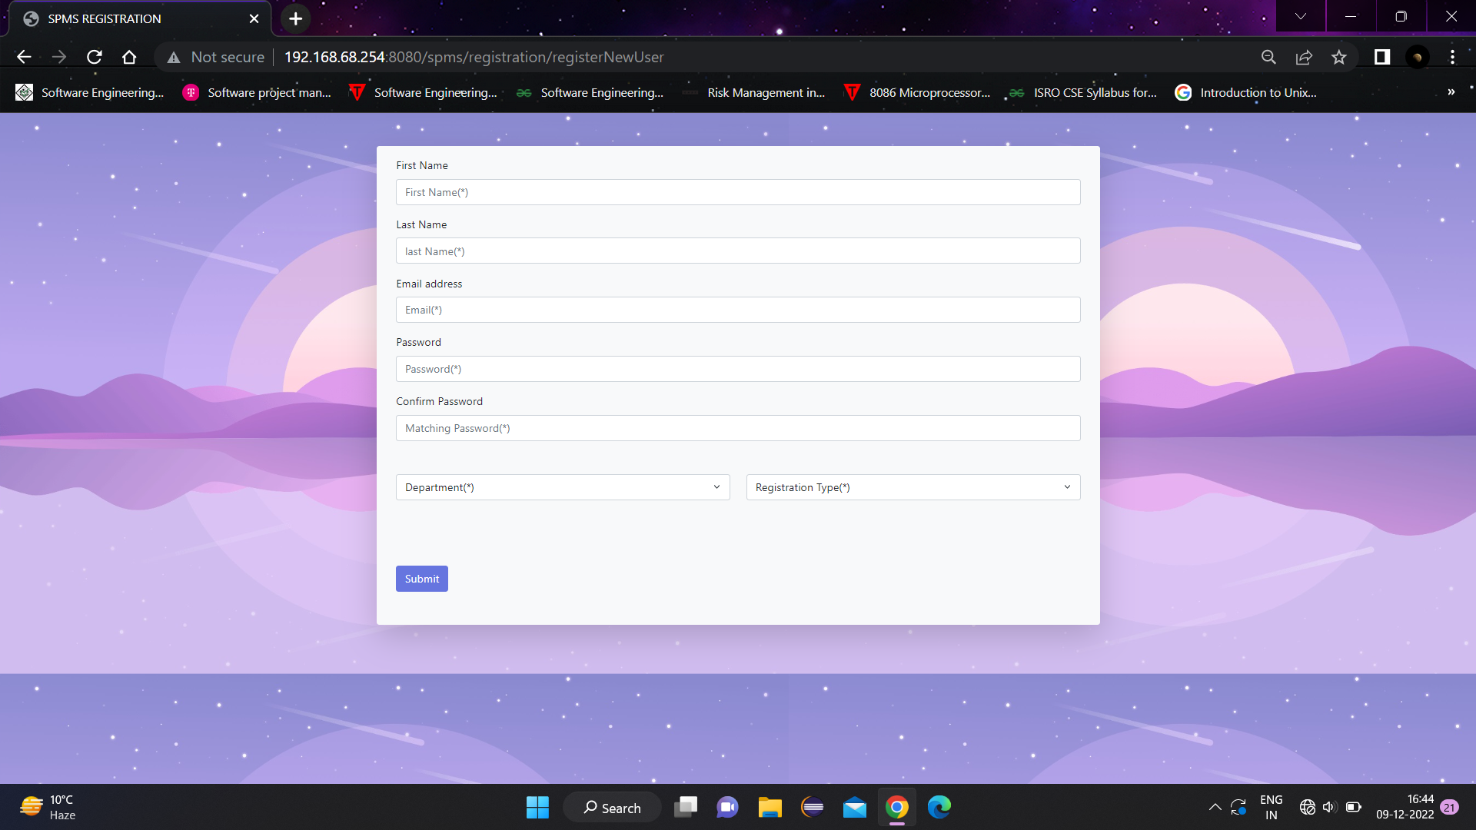
REGISTRATION PAGE

Slide 23
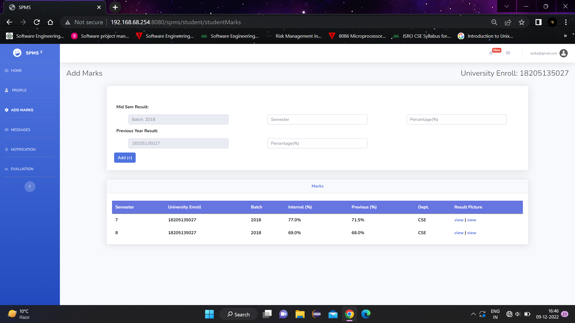
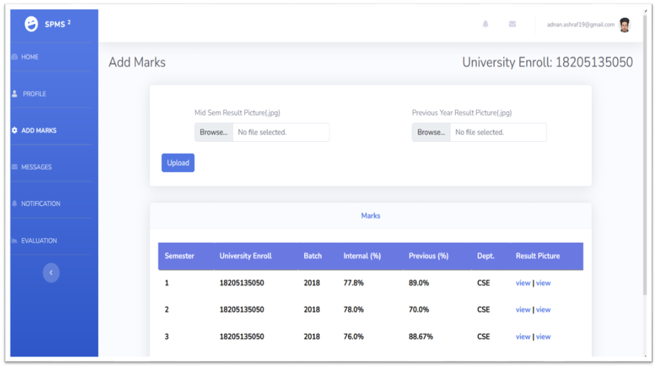
ADD MARKS ,UPLOAD PHOTO

Slide 24
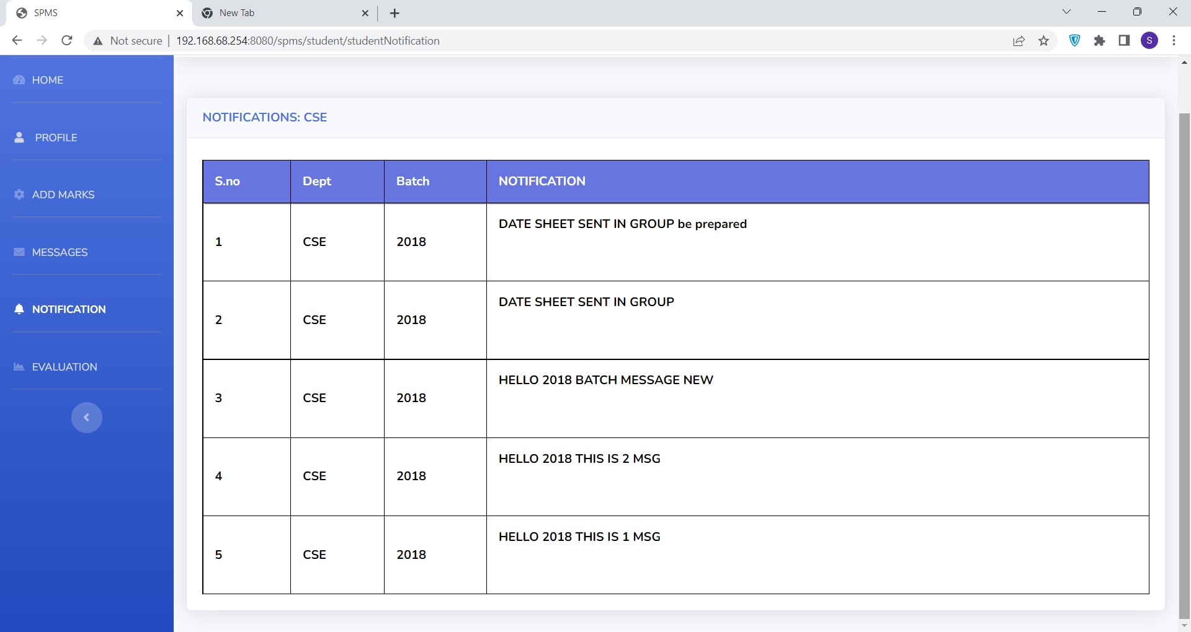
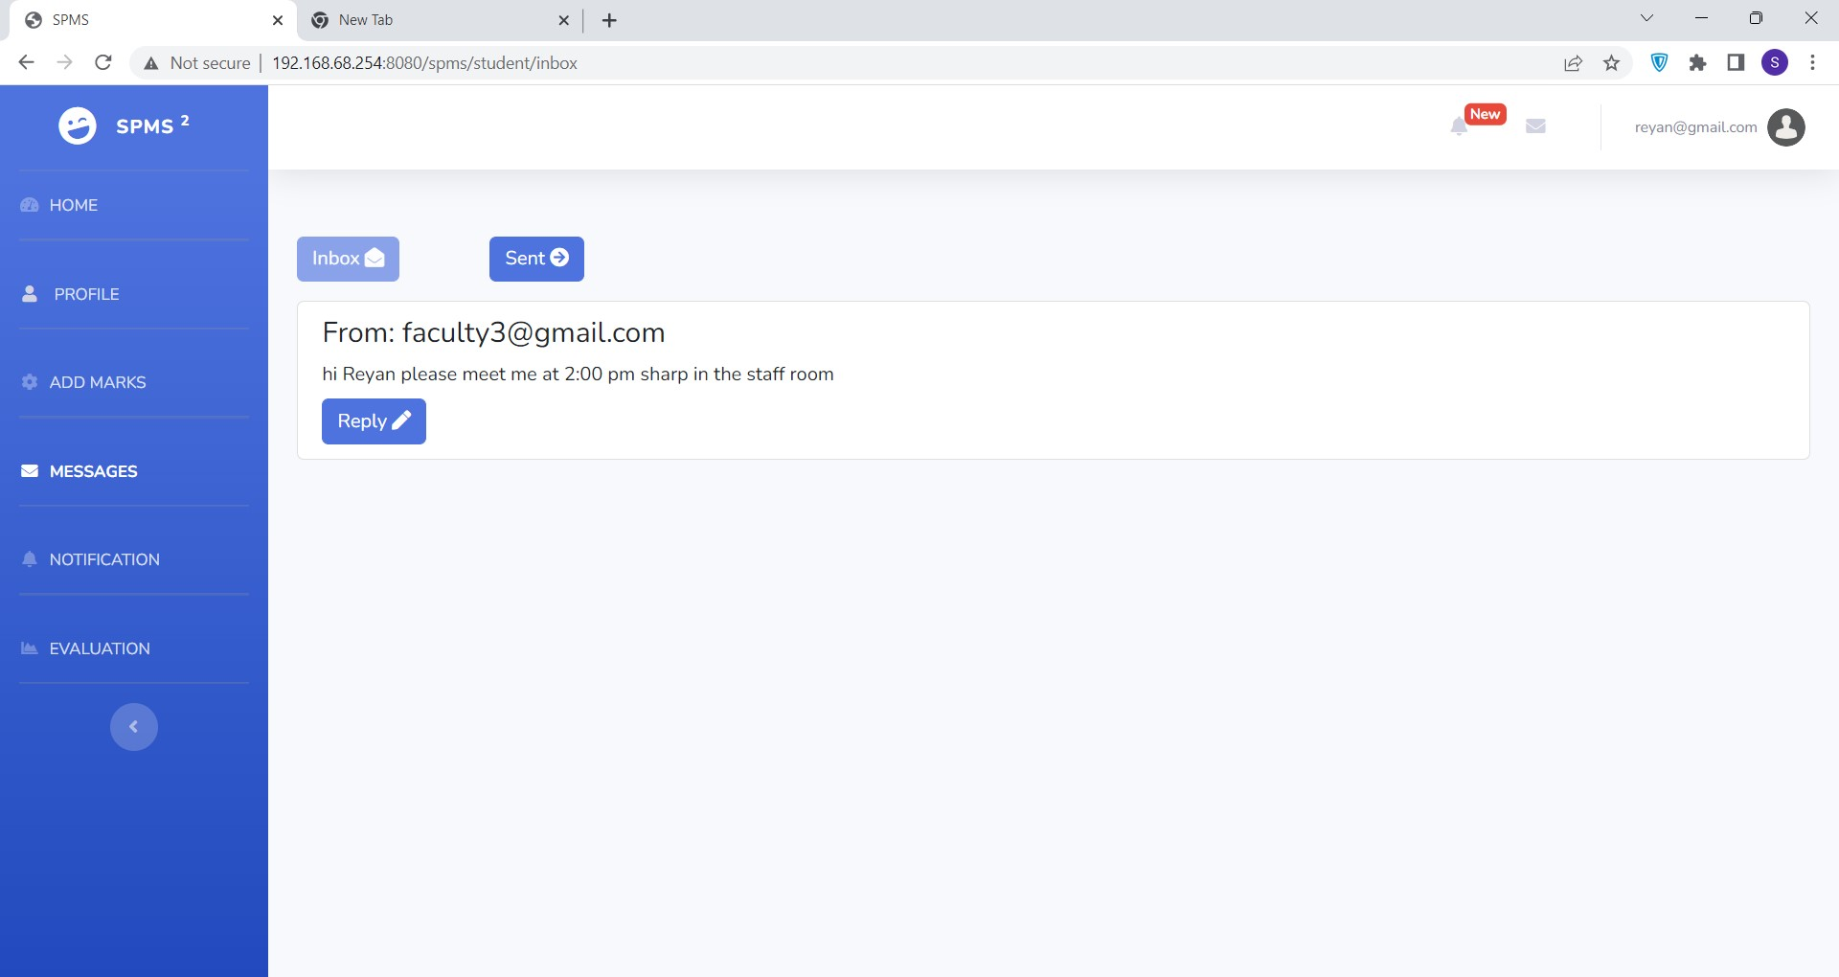
NOTIFICATIONS AND MESSAGES

Slide 25
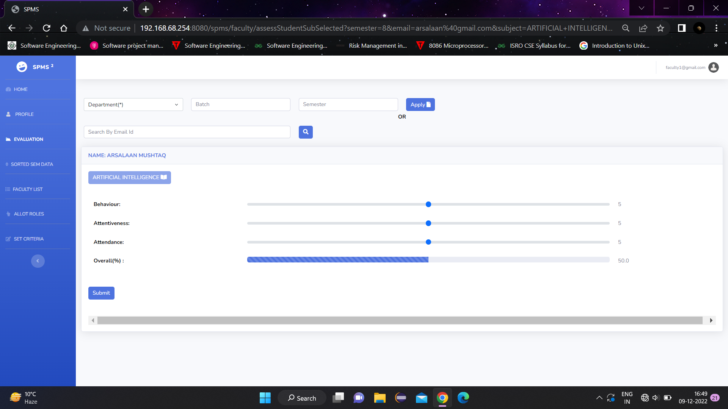
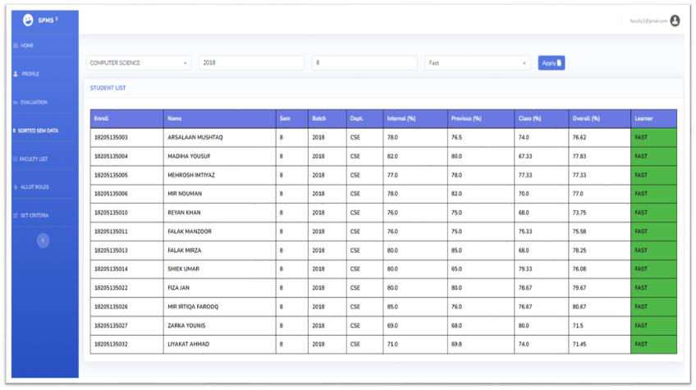
ASSESSMENT AND VIEW LIST

Slide 26
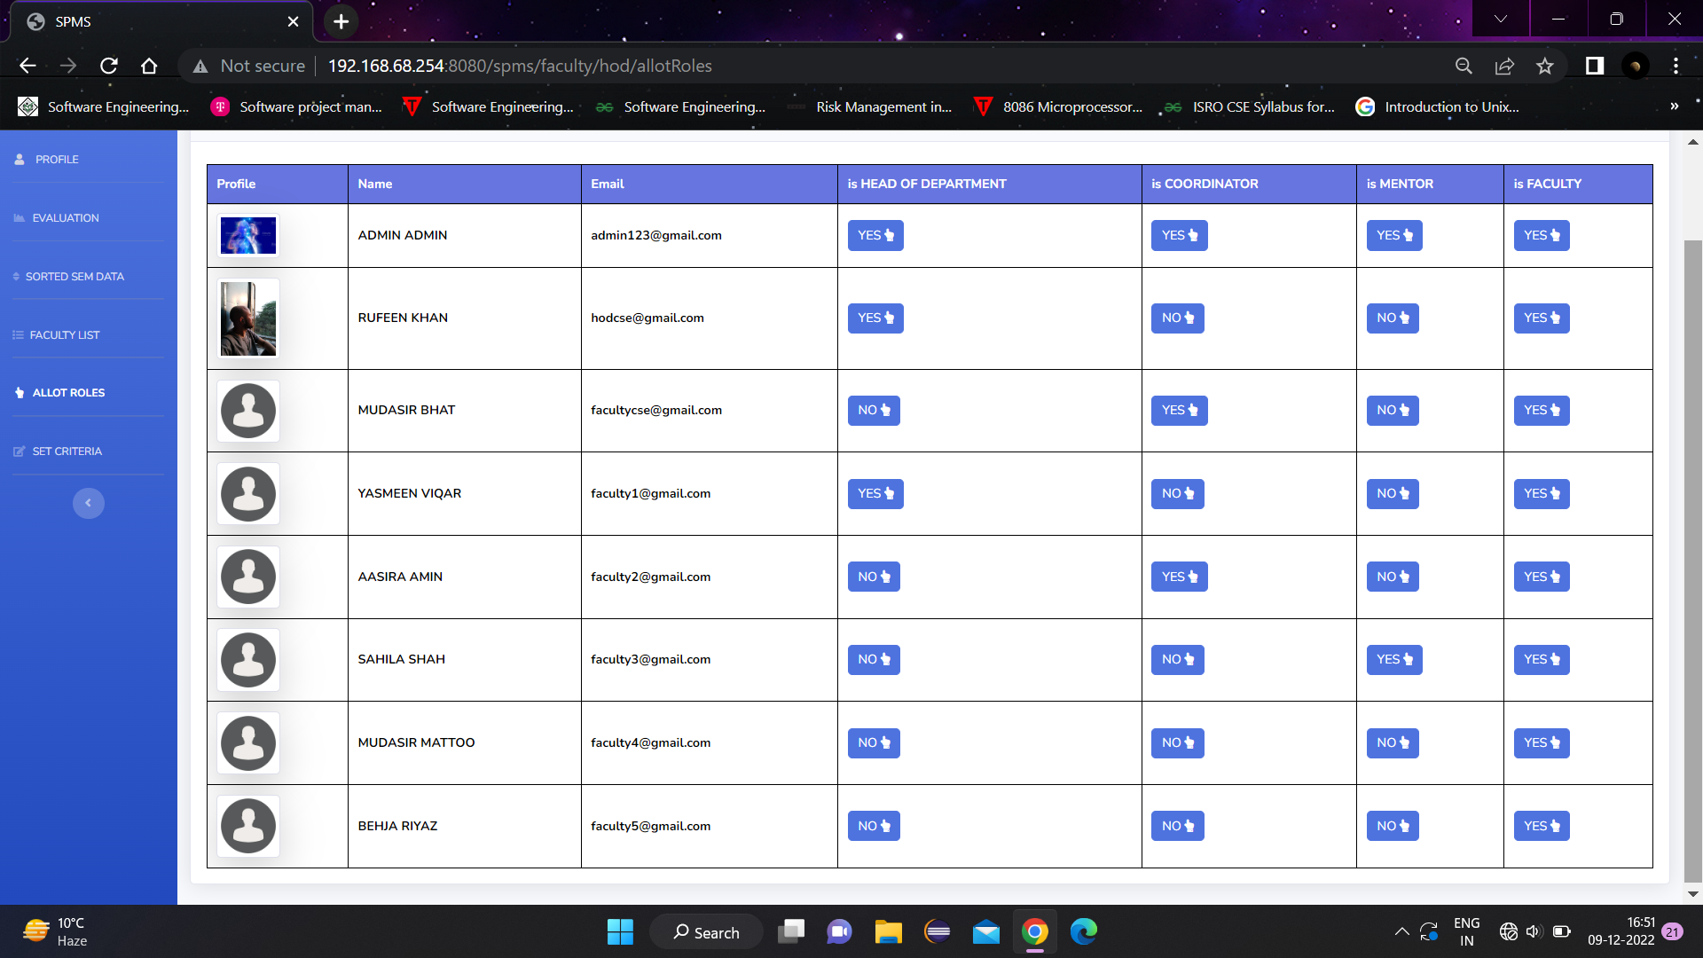
ALLOT ROLES

Slide 27
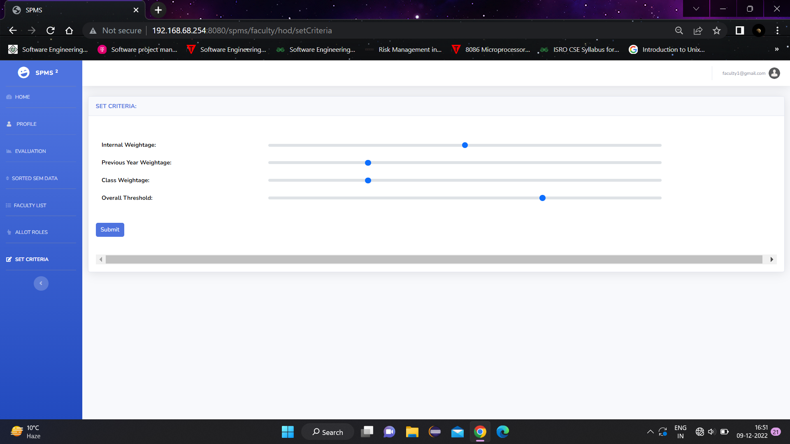
SET CRITERIA

Slide 28
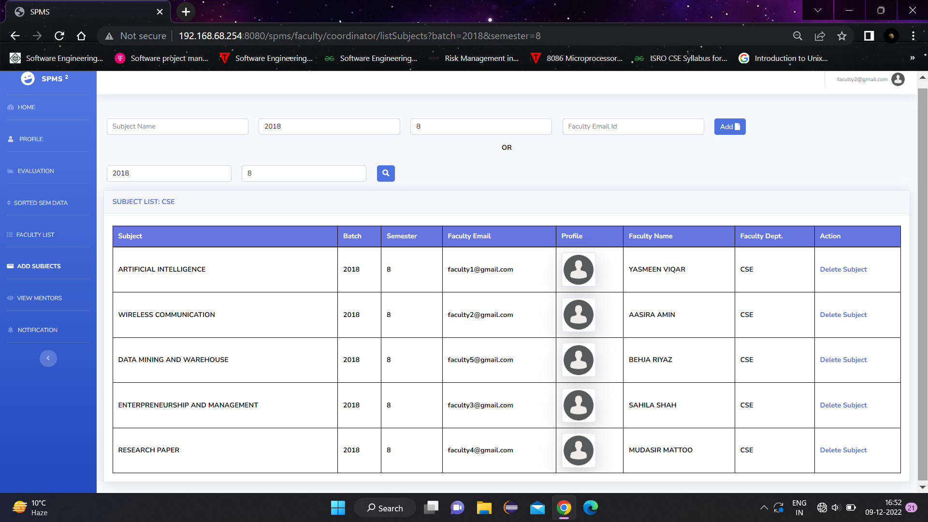
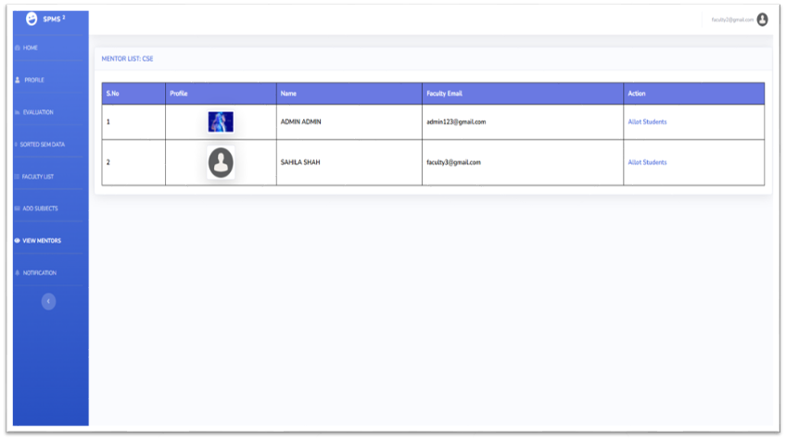
COORDINATOR- ADD SUBJECTS AND VIEW MENTORS

Slide 29
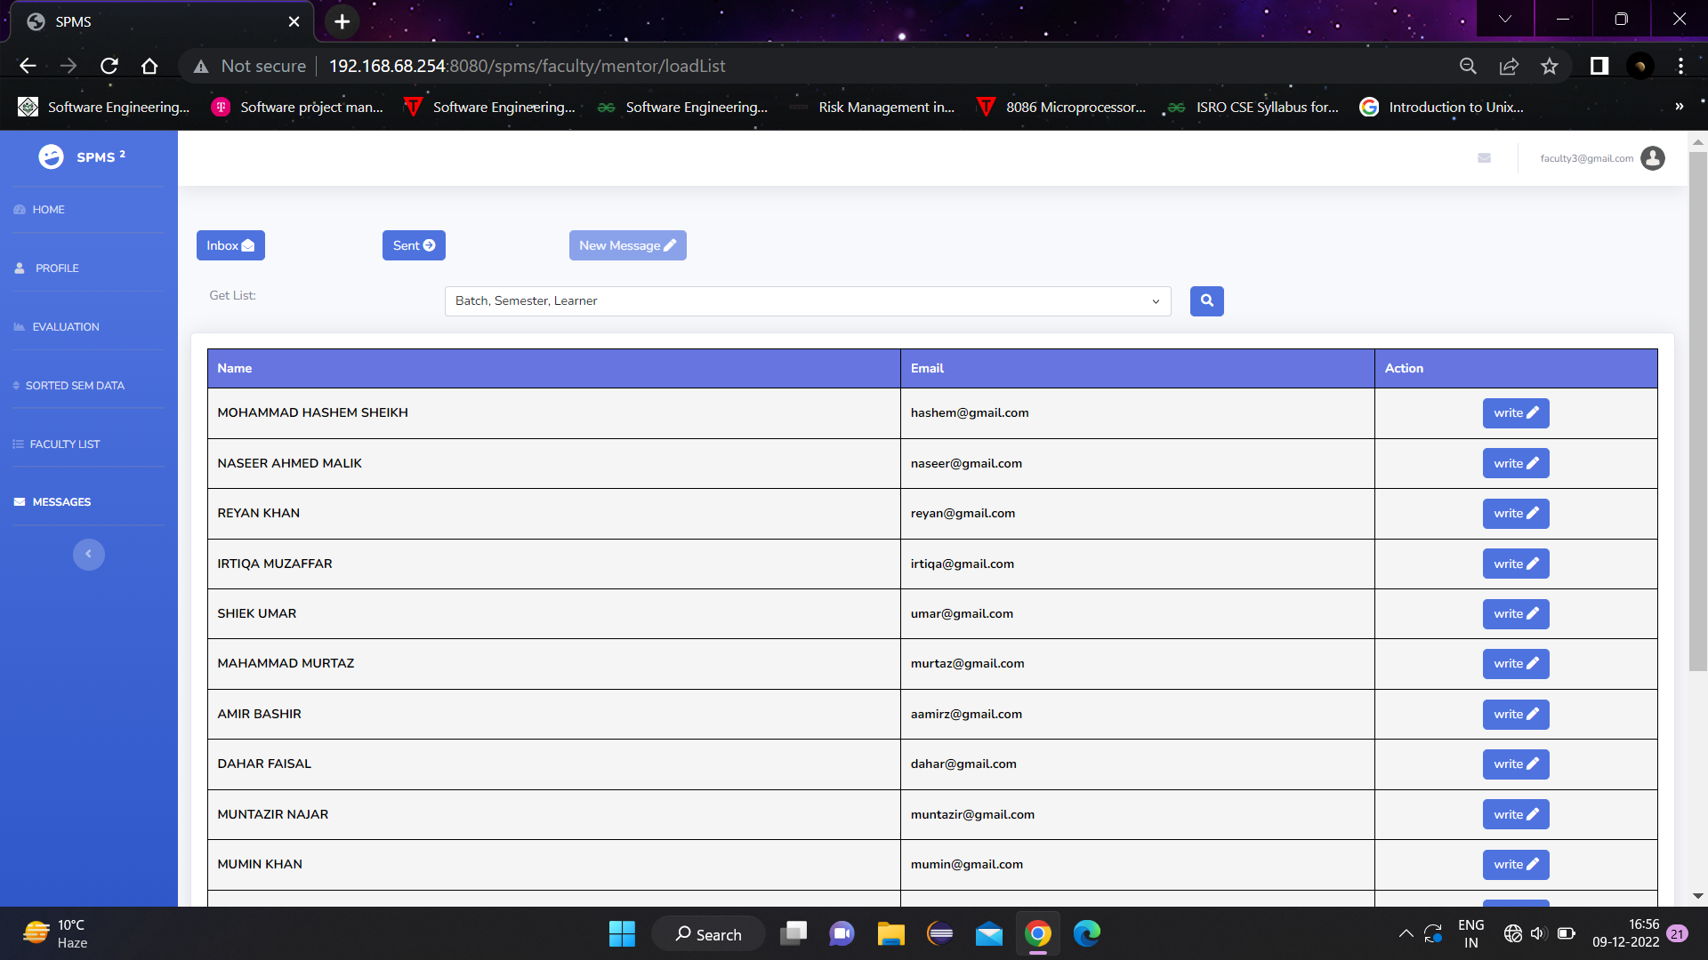
MENTOR- VIEW ALLOTTED STUDENTS AND WRITE MESSAGE

Slide 30

FUTURE SCOPE:
AI LEARNING ALGORITHMS
PREDICTIVE ANNALYSIS
MACHINE LEARNING
TECHNOLOGY OF BOTS
PERSONALIZED MENTORING
SENSORS
EMOTION DETECTING SENSORS
TIME COMPUTATION

Slide 31
CONCLUSION:
With the help of this web application the process of assessment of the learning levels of the students and conduction of activities for them can be carried out in a systematic ,fast and effective manner.
Target assessment of each subject is carried out.
It will further help in improving the results of individual and college/university as a whole.
It will boost the morale of the students at individual level.
All round personality development is achieved.
It will provide better career guidance.

Slide 32
THANK YOU.

